Slide 1
CREATIVE BUSINESS MODEL CANVAS
Here is where your presentation begins

Slide 2
CONTENTS OF THIS TEMPLATE
Here’s what you’ll find in this Slidesgo template:
A slide structure based on a business plan presentation, which you can easily adapt to your needs. For more info on how to edit the template, please visit Slidesgo School or read our FAQs.
An assortment of graphic resources that are suitable for use in the presentation can be found in the alternative resources slide.
A thanks slide, which you must keep so that proper credits for our design are given.
A resources slide, where you’ll find links to all the elements used in the template.
Instructions for use.
Final slides with:
The fonts and colors used in the template.
A selection of illustrations. You can also customize and animate them as you wish with the online editor. Visit Storyset to find more.
More infographic resources, whose size and color can be edited.
Sets of customizable icons of the following themes: general, business, avatar, creative process, education, help & support, medical, nature, performing arts, SEO & marketing, and teamwork.
You can delete this slide when you’re done editing the presentation.

Slide 3
TABLE OF CONTENTS
01
04
02
05
03
06
BUSINESS OVERVIEW
MNGMT. PLAN
You can describe the topic of the section here
You can describe the topic of the section here
MARKET ANALYSIS
OPERATING PLAN
You can describe the topic of the section here
You can describe the topic of the section here
MARKETING PLAN
FINANCIAL PLAN
You can describe the topic of the section here
You can describe the topic of the section here

Slide 4
MISSION
STATEMENT
Here you can describe the company’s mission. A clear message is a good way to get down to business

Slide 5
OUR COMPANY
Mercury is the closest planet to the Sun and the smallest one in the Solar System—it’s only a bit larger than the Moon

Slide 6
01
BUSINESS OVERVIEW
You can enter a subtitle here if you need it

Slide 7

MARKET TRENDS
20%
35%
25%
20%
MERCURY
JUPITER
Mercury is the smallest planet
Jupiter is a gas giant planet
MARS
NEPTUNE
Mars is actually a cold place
Neptune is the farthest planet
Follow the link in the graph to modify its data and then paste the new one here. For more info, click here

Slide 8
PROBLEM & SOLUTION
MAIN PROBLEMS
MAIN SOLUTIONS
Mercury is the closest planet to the Sun and the smallest in the Solar System
Despite being red, Mars is actually a very cold place. It’s full of iron oxide dust

Slide 9
COMPETITORS
A
B
C
MARS
JUPITER
MERCURY
Despite being red, Mars is actually a very cold place
It’s a gas giant and the biggest in the Solar System
It’s the closest planet to the Sun and the smallest

Slide 10
THEM
US
Mercury is the closest planet and the smallest one in the Solar System
Venus has a beautiful name and is the second planet from the Sun

Slide 11
02
MARKET ANALYSIS
You can enter a subtitle here if you need it

Slide 12
TARGET
PERSONALITY
PREFERENCES
Mercury is the closest planet and the smallest
10%
20%
30%
50%
30%
QUIET
LOGICAL
SOCIAL
Mercury is a small planet
Jupiter is a gas giant
Venus has a good name
60%

Slide 13
MARKET SIZE
20%
80%
MERCURY
VENUS
Mercury is the smallest planet
Venus has a beautiful name

Slide 14
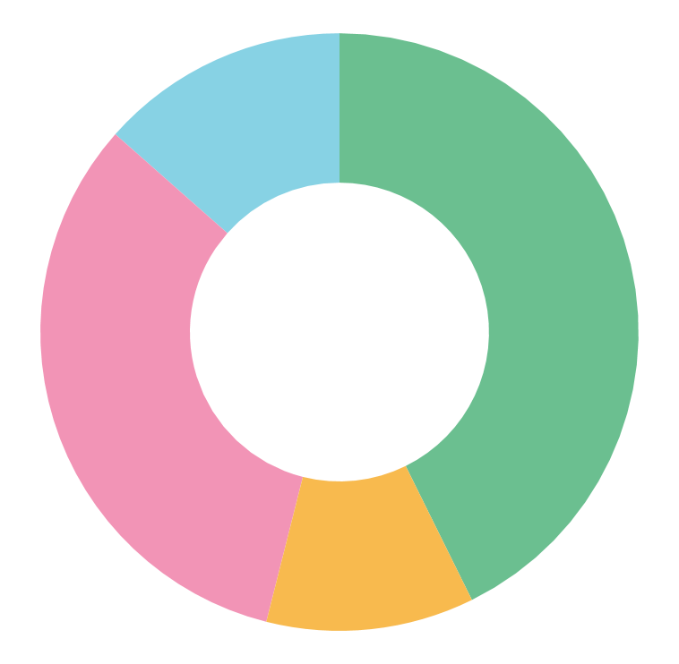
MARKET SHARE
3,800
1,000
2,900
1,200
MERCURY
JUPITER
Mercury is the smallest planet
Jupiter is the biggest planet
VENUS
MARS
Venus has a beautiful name
Mars is actually a very cold place
Follow the link in the graph to modify its data and then paste the new one here. For more info, click here

Slide 15
COMPETITION ANALYSIS
KEY PARTNERS
KEY ACTIVITIES
VALUE PROPOSIT.
CUSTOMER RELATION.
CUSTOMER SEGMENTS
Mercury is the closest planet to the Sun
Venus has a beautiful name
Earth is the third planet from the Sun
This is where we all live on
Mars is actually a cold place
KEY RESOURCES
CHANNELS (ON & OFF)
It’s the second from the Sun
It's full of iron oxide dust
COST STRUCTURE
Jupiter is a gas giant and the biggest planet
REVENUE STREAMS
Saturn is a gas giant and has several rings

Slide 16
OUR ANALYSIS
START: PROBLEM
OUR SOLUTIONS
UNIQUE VALUE
UNFAIR ADVANTAGE
CONSUMER CHANNELS
OUR METRICS
FAIR ADVANTAGE
It’s the second from the Sun
PRODUCT EXPENSES
CASH FLOWS

Slide 17
BUSINESS MODEL CANVAS
Despite being red, Mars is actually a very cold place
It’s the closest planet to the Sun and the smallest in the Solar System
Create your own canvas model by adding post-its from outside the slide and filling them with the text you want. Then move it to the slide and place it wherever you need.
KEY PARTNERS
KEY ACTIVITIES
KEY RESOURCES
It’s the farthest planet from the Sun
Despite being red, Mars is actually a very cold place
Jupiter is the biggest planet of them all
VALUE PROPOSIT.
Mercury is the closest planet to the Sun
Venus has a beautiful name

Slide 18
BUSINESS MODEL CANVAS
It’s the closest planet to the Sun and the smallest in the Solar System
Despite being red, Mars is actually a very cold place
CUSTOMER RELATION.
CHANNELS (ON & OFF)
COST STRUCTURE
Despite being red, Mars is a cold place
Jupiter is the biggest planet of them all
It’s the farthest planet from the Sun
CUSTOMER SEGMENTS
REVENUE STREAMS
Venus has a beautiful name
Mercury is the closest planet to the Sun

Slide 19
03
MARKETING PLAN
You can enter a subtitle here if you need it

Slide 20
OUR SERVICES
MERCURY
VENUS
NEPTUNE
Mercury is the closest planet to the Sun
Venus is the second planet from the Sun
Neptune is the farthest from the Sun
SATURN
JUPITER
MARS
Saturn is a gas giant and has several rings
Jupiter is the biggest planet of them all
Despite being red, Mars is a cold place

Slide 21
OUR PARTNERS
Do you know what helps you make your point clear? Lists like this one:
They’re simple
You can organize your ideas clearly
You’ll never forget to buy milk!
And the most important thing: the audience won’t miss the point of your presentation

Slide 22
BREAK-EVEN ANALYSIS
-20M
BIG LOSS
Mercury is a small planet
-10M
LOSS
Saturn is the ringed planet
0
BREAK-EVEN POINT
Venus is the second planet
10M
PROFIT
Jupiter is the biggest planet
20M
HIGH PROFIT
Mars is actually a cold place

Slide 23
OUR PLANS
BASIC
STANDARD
PREMIUM
PRO
Venus is the second planet from the Sun
Despite being red, Mars is a cold place
Mercury is the closest planet to the Sun
Jupiter is the biggest planet in the Solar System
$30
$50
$80
$120

Slide 24
SALES AND DISTRIBUTION
MARS
JUPITER
Mars is a very cold place
Jupiter is the biggest planet
01
02
03
04
VENUS
MERCURY
Venus is the second planet
It’s the closest to the Sun

Slide 25
AWESOME WORDS

Slide 26
ADVERTISING AND PROMOTION
ADVERTISING
Mercury is the closest planet to the Sun and the smallest
PR
Venus has a beautiful name and is the second planet
ONLINE
Despite being red, Mars is actually a cold place

Slide 27
—SOMEONE FAMOUS
“This is a quote, words full of wisdom that someone important said and can make the reader get inspired.”

Slide 28
04
MNGMT. PLAN
You can enter a subtitle here if you need it

Slide 29
OUR TEAM
BETH MAYER
Here you can talk a bit about this person
KHRIS JOHNSON
Here you can talk a bit about this person

Slide 30
ORGANIZATIONAL CHART
TEAM 1
Mercury is the closest planet to the Sun
TEAM 2
Venus has a beautiful name and is the second
CEO
TEAM 3
Saturn is a gas giant and has several rings
TEAM 4
Despite being red, Mars is actually a cold place

Slide 31
05
OPERATING
PLAN
You can enter a subtitle here if you need it

Slide 32
OUR PROCESS
NEPTUNE
MERCURY
1
2
Neptune is the farthest planet
Mercury is the smallest planet
JUPITER
MARS
3
4
It’s a gas giant and the biggest
Mars is actually a cold place

Slide 33
PREDICTED GROWTH
65%
80%
45%
Saturn is a gas giant and has several rings
Jupiter is a gas giant and the biggest planet
Neptune is the farthest planet from the Sun

Slide 34
BALANCE SHEET
 | 2020 | 2021
FIXED ASSETS | $ 10,000 | $ 10,300
CURRENT ASSETS | $ 9,160 | $ 9,250
GROUP EQUITY | $ 15,800 | $ 13,900
TOTAL LIABILITIES | $ 12,500 | $ 13,170

Slide 35
THANKS!
Do you have any questions?
youremail@freepik.com
+91 620 421 838
yourcompany.com
Please keep this slide for attribution

